Slide 1
Project
Presentation
Anany Sharma
SWE Resident

Slide 2

Company Name
self == team.lead
Anany Sharma
SWE Resident
Experienced AI software engineer with expertise in machine learning, computer vision, and system design. Contributed to edge AI,RAG, and holds a patent for crowd detection, aiming for senior roles.

Slide 3
Company Name
Contents
Year/Quarter/Month
1. Problem
2. Solution
3. Diagram
4. Demo
5. Struggle
6. Future

Slide 4
LLM-Powered Autonomous Trading via Custom MCP Server
Retail traders face challenges with manual, time-consuming market analysis and emotional trading.
This AI-powered MCP server with GitHub Copilot automates trading, provides instant insights, and manages portfolios through natural language, eliminating manual effort and emotional bias.

Slide 5
Company Name
Project roadmap
Goal
Step 1
Step 2
Step 3
Step 4
Year/Quarter/Month
Learn about MCP, frameworks, Integration platforms and scalability.
Ideation and brainstorming about a suitable and viable use case to build a MCP server on.
Creating a sample MCP in an end to end setting to understand the workflow and architecture
Integrating API’s with server and creating a whole ecosystem of server tools to solve and automate the problem
Retail traders are able to efficiently place their bets on stocks based on LLM reasoning and basic research.

Slide 6
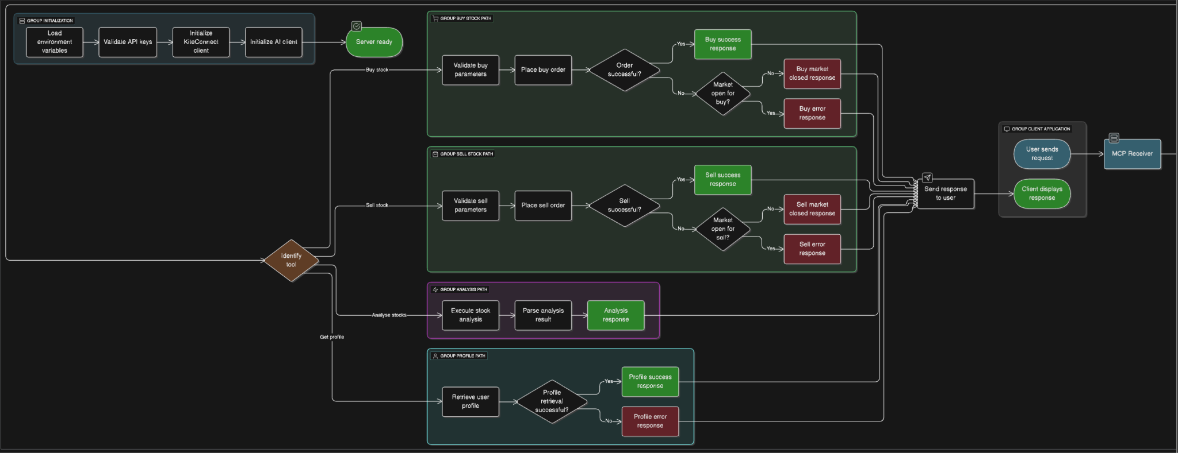

Slide 7
Company Name
The solution
Year/Quarter/Month
MCP (Model Context Protocol)
The Model Context Protocol (MCP) is an open standard designed to bridge the gap between AI systems (like large language models such as those powering GitHub Copilot) and external tools, databases, and services. Think of it like a universal adapter or a USB-C port for AI integrations.
How it solves the problem? (Model Context Protocol)
MCP solves complex AI-tool integration by providing a standardized communication protocol. It allows AIs like GitHub Copilot to discover and execute external tools (e.g., Zerodha Kite API) and access real-time context. This eliminates fragmented integrations, context loss, and limited real-world interaction, enabling seamless, dynamic automation for tasks like trading.

Slide 8
Company Name
Struggles
Potential challenge
How I responded
Understanding about MCP, how to implement and learn about available frameworks.
Read Blogs from AI Engineers, reviewed existing MCP server implementation. Watched Youtube tutorials of how to implement an MCP server.
1
Identifying real world pain points where MCP can make things efficient and user convenient
Brainstormed about scenarios where users lack control due to complex integration and where AI lacks real time context,etc
2
Implementing remote MCP server on different clients
I am still not to sure if Claude Desktop supports remote MCP integration but found github co-pilot doing it so I implemented it.
3
Year/Quarter/Month

Slide 9
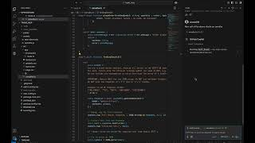

Slide 10
Future Work
Year/Quarter/Month
Implementing more tools from the Zerodha API to server an all around experience. Implementing strategies just through natural language would be a game changer.
Creating a Custom Chat Interface as a MCP Client for enhanced security and privacy of users.
Integrating outside tools from X, macroeconomic news to capture sentiments and make trades well before the crowd just using the chat

Slide 11
Thank you

